Slide 1
Dynamics
Teaching and learning activities

Slide 2
What is Energy?
What is Motion?
What is Rest?
What is Force?
What is Opposition?

Slide 3
It’s all about motion! Is it? Let’s find out
Let’s talk about energy.
Can you move! when you have energy? when you don’t have energy?
Let’s talk about force.
So again, can you move! When you don’t apply any force? When you apply some force?
What is to be at rest -> there’s no motion.

Slide 4
(a) state Newton’s third law.
When we throw a ball on floor, it bounces back? W H Y?

Slide 5
What is Force?
Force is either a Push OR a Pull
What force can do?
Move an object.
Stop a moving object.
Change the size of an object.
Change the shape of an object.

Slide 6
Newton’s Laws of motion
Newton’s first law
Notes:
(c) describe the ways in which a force may change the motion of a body.

Slide 7
(d) recall Newton’s 2nd law and use the equation force = mass × acceleration.

Slide 8

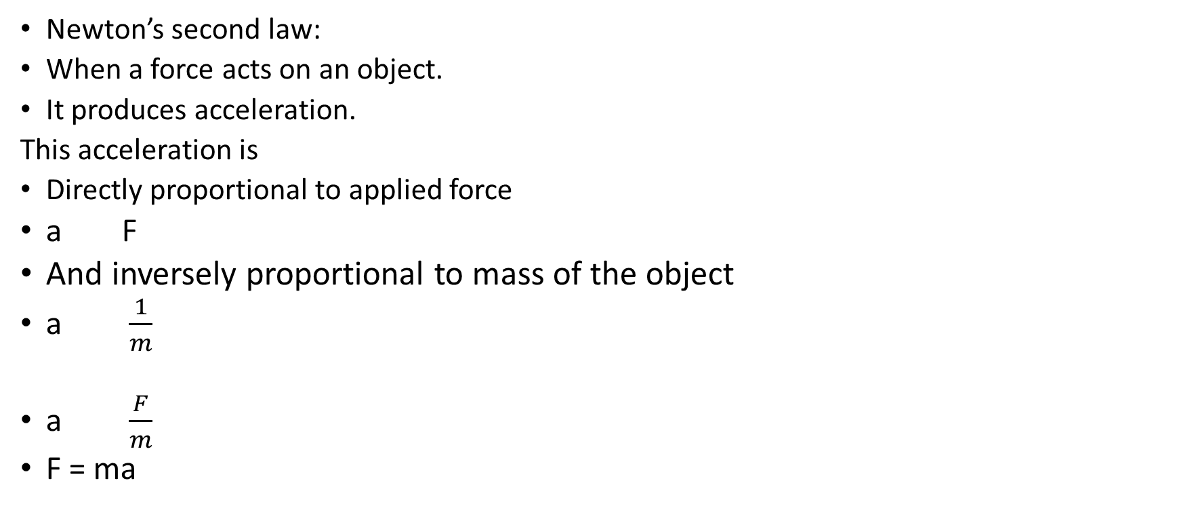
Newton’s Laws of motion
Newton’s second law:
When a force acts on an object.
It produces acceleration.
This acceleration is
Directly proportional to applied force
a F
And inversely proportional to mass of the object
a $\frac{1}{m}$
a $\frac{F}{m}$
F = ma

Slide 9
Diary 7/3/20
Complete Task 3.1 (P-34) and Task 3.2(P-37)

Slide 10

Newton’s 3rd Third Law – for every action, there is an equal and opposite reaction.

Slide 11
When we pedal our bike, the tyre applies a force on ground.
This force doesn’t produce motion in ground because the ground is very very big.
This is the ACTION of tyre on the ground.
Now according to Newton’ third law of motion, the ground applies and equal and opposite force on the tyre.
This force applied by ground on tyre is LARGE ENOUGH to move the bicycle.
This is the REACTION force of ground on tyre.

Slide 12
quiz
Open Socrative all and attempt the quiz when prompted.
Each question’s answer will be viewed by me and given feedback on.

Slide 13
Socrative activity: How do we represent a force on paper?
You must have done it in Ch#.1 so this is a quick revision.
A 300N force is acting towards north. Explain how will you represent it on paper.
Step 1:___Choose Scale_________________
Step 2:___Understand direction__________
Step 3:___draw line according to scale and direction

Slide 14
(b) describe the effect of balanced and unbalanced forces on a body.
What happens when one force acts on an object?
[Socrative]
An acceleration is produced in the object.
What happens when more than one force acts on an object?
Well when two forces act on an object, they can either be (i) balanced forces or (ii) unbalanced forces

Slide 15
What are balanced forces.
When two forces are equal in magnitude and exactly opposite to each other, they are balance because their effect on the object will be zero or null.
For example: when two persons of equal strength are pulling a rope in opposite direction and the rope is staying in position.
What are unbalanced forces.
When two forces are not equal in magnitude nor exactly opposite to each other, they are unbalanced because their effect on the object will be vary.
For example: A child and a big persons pulling a rope in opposite direction, the rope will...
So now, out the two forces acting, the object will move along the bigger force.

Slide 16

(e) explain that friction is a force that impedes motion and produces heating.
What is a smooth surface?
A smooth surface means the surface of an object is like a flat line and not humps.
Because everything is matter. Matter is made of atoms. Atoms are circular and thus form the top, no surface can be perfectly smooth. This is how they look like:
So when two surfaces which are not perfectly smooth come in contact, they rub above each other. This causes a drag of one to the other and vice versa.
This drag thus produced is known as friction.
Friction is a force that opposes motion.
Friction depends upon the type of surfaces that are coming in contact with each other.
Friction is very useful in our everyday life. We can walk because our shows provide friction against the ground.
If the ground is slippery, we find it very hard to walk.
A car can be stopped from very high speed because of friction between tyres and ground.

Slide 17
But in so many things friction is not desirable and it needs to be eliminated.
Like in the engines when it runs the metal parts rub against each other and need lot of lubricants to work.
When we want to drag something without wheels, it requires lot of force due to large friction between itself and the ground.
So friction is a force which ‘impedes’ or resists and tries to stop motion of any kind.
Friction can be reduced but it can never be eliminated 100%. It will be present.
Even air also offers friction when anything passes through it like aeroplane or car or bike.
Water provide friction when things pass through it like boats, ships.
Tyres are made of rubber and road is kept rough to allow friction between the two.

Slide 18
(f) discuss the effect of friction on the motion of a vehicle in the context of tyre surface, road conditions (including skidding), braking force, braking distance, thinking distance and stopping distance.
Stopping distance = Thinking distance + Breaking distance
Thinking distance: the distance a vehicle covers when driver see a hazard and applies breaks.
Stopping distance: the distance a vehicle covers when driver applies breaks and the vehicle comes to rest.
Factors affecting thinking distance: influence of drug, mobile phone, in-car dvd, chatting.
Factors affecting breaking distance: worn out tyres, wet road, heavy load.
calculations.

Slide 19
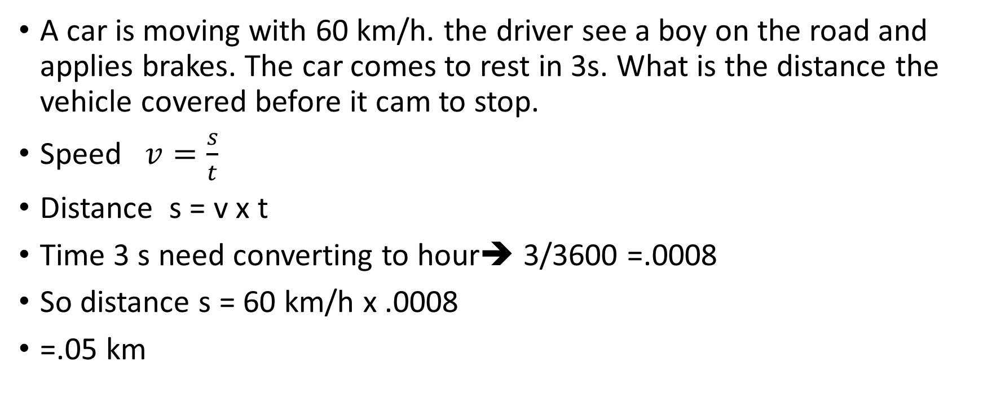
How to calculate stopping distance
A car is moving with 60 km/h. the driver see a boy on the road and applies brakes. The car comes to rest in 3s. What is the distance the vehicle covered before it cam to stop.
Speed $v=\frac{s}{t}$
Distance s = v x t
Time 3 s need converting to hour➔ 3/3600 =.0008
So distance s = 60 km/h x .0008
=.05 km

Slide 20
Motion in a circular path
motion in a circular path is due to a constant perpendicular force acting on it from the centre of a circle in which is trying to move.
This constant perpendicular force is named as centripetal force because it is always directed towards the centre of the circle.
Examples:
Car turning around a bank (road). The necessary centripetal force is the force of friction between the tires and the road.
electrostatic forces on an electron in an atom
gravitational forces on a satellite.
Notes:
(g) describe qualitatively motion in a circular path due to a constant perpendicular force, including electrostatic forces on an electron in an atom and gravitational forces on a satellite. (F = mv²/r is not required.

Slide 21


Slide 22
(h) discuss how ideas of circular motion are related to the motion of planets in the solar system.

Slide 23
Rockets
What’s newton’s third law of motion? every ACTION has REACTION
So anything lying on earth, what’s action - the weight; what’s reaction the reaction force of earth.
Is our above definition of Newton’s third law complete? NO.
But this one is: What’s newton’s third law of motion? every ACTION has an equal and opposite REACTION.

Slide 24
Rockets - every ACTION has an equal and opposite REACTION.
So, again think of an object at rest. It’s at rest because…
It has ACTION and REACTION which are equal and opposite.
Now, let’s do some action

Slide 25
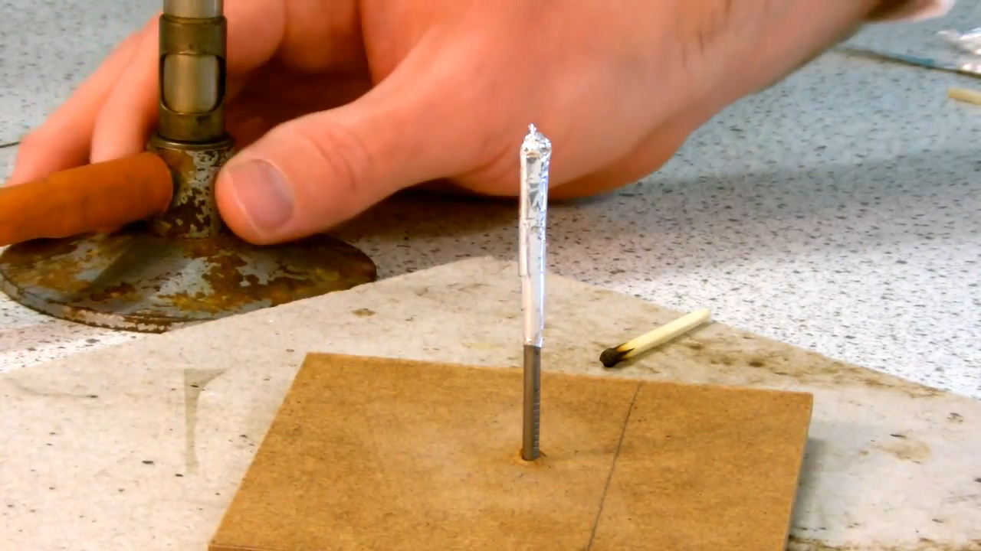
let’s do some action

Slide 26
Conclusions
What did you saw?
Why it happened?
So this how a rocket works.
The gases preform some action by coming out from the back, the rocket moves forward very fast as a reaction.
Conclusions - every ACTION has an equal and opposite REACTION.

Slide 27
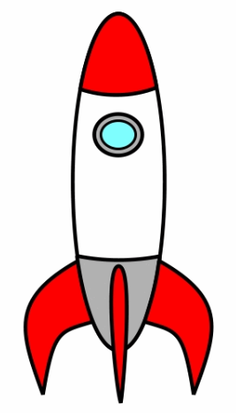
Rocket
REACTION - The rocket moves forward very fast.
ACTION - The gases come out after rocket fuel is burnt

Slide 28
Physics Homework Instructions
Homework of physics is an important part of your learning.
Completion of your homework gives me, your teacher of physics, an effective way to assess your learning.
I am able to give you very useful feedback in the light of your honest attempt of completion of homework.
Your homework task will mostly be on Socrative. The quiz will be online and you will need room id JAMIL2725 to enter and complete it.
Two tasks will be required from you:
Complete your task on Socrative 2. copy it on your notebook.
When you will complete your task on Socrative, I will review it and give you feedback accordingly.

Slide 29
Today in Physics class, I will be giving you guidelines on how to attempt Q11 to Q15.
If you have already done, you can verify if your attempt is in the right direction.
Q11- b- you have done this. You can watch the video again and draw the diagram.
Q12 – you just have to draw arrows in all four directions and name the forces that act along these arrows.
Q13 – this is a numerical. Make an attempt and I will give you feedback.
Q14 – a – you will need to revise terminal velocity and balanced and unbalanced forces. When an object will be moving with constant velocity – answer in terms of balanced / unbalanced forces.
Q14-b-the drag force is the opposition to downward force which is the weight of any object. so think when it will be maximum?
Q14-c-thinking about freely falling body, when the object will decelerates?? Only when resultant force increases. So when the parachute is opened, there is lot of air resistance due to area of parachute – this results in what??
So thinking along the same lines – when the object was falling without parachute opened, the resultant force was its weight why? But when the parachute was opened, the resultant force was air resistance. Why?
Q15 – I think you can do it yourself.

Slide 30
DIARY 15-4-20
Test of MCQ (outside book) tomorrow

Slide 31
Mcq ASSESSMENT 25-4-20
Go to Showbie
Click on PHYSICS
Click on assignment “SLO 3-Dynamics Final Assessment”
In shared items, there are two quiz. Attempt them BOTH.
THE FIRST QUIZ WILL END AND SECOND QUIZ WILL START AT 3:10
DEADLINE 3:55 PM today

